Slide 1

YOUVAVESTORS
HACKFORCAUSE 2.0
Problem statement: Finance
Team Name : BitTheory Backbenchers
Team ID : 2107
Team Members : Aditya Arun Iyer
Apoorv Shah
Vanisha Agarwal
Joseph Tonio David
POST-COVID DIGITIZATION
START EARLY, START Strong!

Slide 2

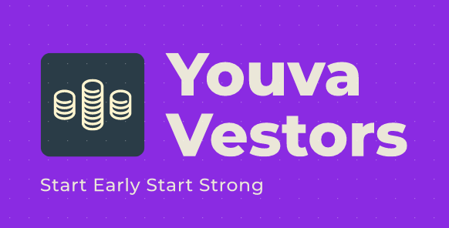
We believe in financial literacy

Slide 3
About Us
We at youvavestor understand how the times are changing and how the world changes too.
We realize that the young adults of today can be intimidated by finance and investment and our main goal is to help today's youth achieve financial freedom and literacy
We aim to instill confidence in today’s youth to take the first step towards financial stability
We are four members that believe in this same ideology goal is to help todays youth achieve financial freedom and literacy. giving them a better understanding of how to move forward in life with their financial goals

Slide 4





The Problems
Declining Market
Financial
Trust
Cost
Employability
The market has seen a decline like no other due to the COVID pandemic
Students have had to put their careers on halt while the middle-aged workers are facing a heavy cash crunch.
Several insurance companies burdened the COVID-19 economy loss on policyholders. Insurance premiums hence resulted in a hike of approximately 10-20%.
Cost of living surged during the pandemic forcing many to find new places to stay
With people becoming less and less employable, thousands of jobs were lost due to the covid pandemic skyrocketing the unemployment rate

Slide 5




The Solution
Financial Education
Skill Education
Investing
Educating the youth about when to invest and how to invest smartly
Ensuring the working population is given skill education to increase employability
Monetize the youth and promote financial stability overall for people and resume cashflow within the market.
An Investment Platform for the leaders of tomorrow

Slide 6
It’s implementations:
Declining Market
Financial
Trust
Cost
Employability
The cashflow would increase within the market with the youth investing more and more ensuring the market’s revival
The youth often do not feel the need to become financially stable, before it’s too late. We try and educate them with the benefits of it increasing financial stability of society as a whole
We form a bridge between the investors and the market to ensure the needs of both sides are considered and try to ensure both benefit from the increased transactions
Affordability is a major factor in how a person shapes his life. When attaining financial stability, one can ensure to attain the ability to afford their basic needs
Our company has an in-vitro skill education setup integrated with company policy to ensure that our employees grow in their skill-set.

Slide 7
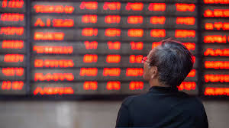




Product
Unique
Grassroot solution
Our product is the first to cater to investing by the youth
We bridge the knowledge gap to increase market participation
Prototyped
Social Media
One-stop solution to people finding Their feet in the investment sector
Our Algorithm after rigorous prototyping is proven to be efficient and will be updated regularly
Focus to increase footprint to reach more of the youth

Slide 8
Basic Structure of the solution
The key as we said before lies in compounding!
Why compounding?
Why start early?
Compounding will exponentially increase your returns!
1^365=1
1.01^365=37.78
just a 1% investment
gives a return of over 37 times the principal
Starting investing in your 20’s can almost triple your returns much quicker!
It is also observed that by delaying by 20 years(Avg investor age in India is 40) makes you lose out on 30-40% more returns.

Slide 9
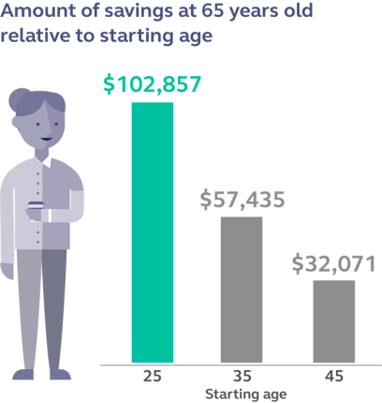

Slide 10
Business Model
A good company always needs a good plan.

Slide 11
Competition Analysis
Why our solution is better?
Competition
Our platform doesn’t cater purely to consumers with investment capability alone, we provide services for anyone and everyone with the youth(Largest section of the population) being the primary consumer.
It caters to the investor individually and the custom nature of our algorithm makes it ideal for consumer looking for personalized financial advice.
The bridges the gap between investor and the market increasing the chances of both their requirements being conveyed and mutually agreed.
The competition that exists currently caters mainly to the working population and there doesn’t exist any such opportunity for the youth.
There are many investment platforms that charge large sum of money for the same result due to the large working cost. However, our solution provides a cost-effective platform to guide investors.

Slide 12



Competition
Convenience
Expensive
Affordable
Inconvenient

Slide 13


Basis for building and improving our services
We as a company recognize that
Research
Finance
Invest
Constantly implementing new technology and updating our service to reflect the current market scenario.
Ensuring that our company handles transactions in the best way possible
Ensuring the company brings the best and current investment opportunities to its consumers

Slide 14
Relation to covid scenario
With a large percent of the population, especially among students struggling with a financial crisis, we found and tackled the root cause.
Early investments help as a support during rough financial periods. With this initiative we aim to provide a financially safer post-covid world for many.
We also noticed that there is lack of financial education among the young-aged investors. Thus the trust in the market and affordability of the consumer depreciates.
Our company focuses on not only enhancing the initiative but also plans on improving the technical skills of its employees, making them more employable for the future.
The bridge between the market and the consumers helps aid us to get the requirements of both sectors be expressed and satisfied.

Slide 15
ECONOMIC FEASIBILITY
Striking partnerships with up and coming Fund Houses and Broking platforms
Plans to include newer forms of investments on the platform like crypto currencies and NFT’s
Advertising financial related services
Partnering with college clubs and financial societies

Slide 16
Our Growth Strategy
We hope to build a strong base as a company within the market both as an employer and a service provider. Our business plan focuses initially on sustenance within the market and then moves on to upscaling and profit.
The plan here is to sustain the market in such a competitive environment
Month 24
Month 12
A new plan shall be put into effect, aiming profit maximization and making our resources cost effective.
Month 6
By this time, we plan to recover at least 50% of what we invested initially.

Slide 17
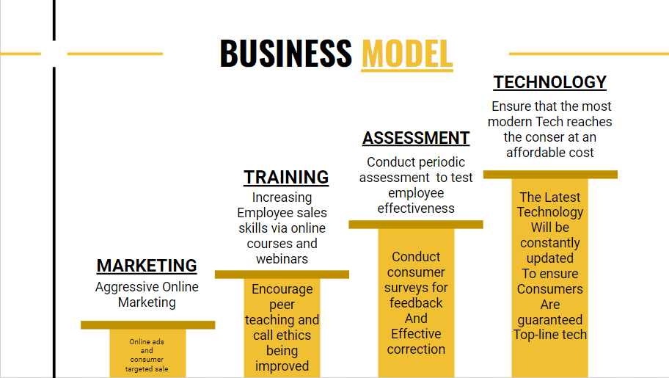

Slide 18
Prototyping and implementation

Slide 19
Algorithms and software's used
Algorithms
Software's Used
We used a simple input algorithm taking answers from a series of simple questions put forth to our clients, to project their needs.
This information is fed into another algorithm that utilizes the options chosen and optimizes an investment scheme., that maximizes the probability for a good return.
We decided a simple database interface for login, signup and storing information
Language Used :
HTML
CSS
JavaScript
PHP
Java
Compatible Browser, xampp control panel
Prototyping and algorithm debugging:Netbbeans GUI
Softwares used: VSCode, Atom, Geddit, Photoshop.

Slide 20
Live Demo of Front-End and Back-End implementation

Slide 21
Timeline
Our action plan
Launch in India
World-wide Launch
Trials
Marketing
2021
2022
2022
2023
AUG
SEP
OCT
NOV
DEC
JAN
FEB
MAR
APR
MAY
JUN
JUL
AUG
SEP
OCT
NOV
DEC
JAN
FEB
MAR
APR
MAY
20YY
Legislation
Investment
2021
2022

Slide 22


Ideals of the company
Fight the economic depression caused by COVID
Skill Education
Ensuring our employees are more employable and providing technical education .
Financial Education
Economic stability
Ensurig the population is financially educated
Ensure the economic stability is widespread especially among the youth

Slide 23
Summary
With our dedicated efforts, we hope to build a more financially stable world with harmony between the investors and the market.

Slide 24

Thank You

